Slide 1
بسم الله الرحمن الرحیم

Slide 2


Kabul university faculty of Information and communication Technology
Science and information engineering Department
Security system of the database Engine
Authorization

Slide 3
Objects:
What is Authorization
The three transact SQL-statement related to authorization
Managing permission using SQL server MS
Changing trucking
Data security and views

Slide 4
What is authorization?
Authorization means specific the user levels access to database and data, or able to execute statement or perform specific operation on database like Read our data, update our data, Delete our data and more operations.
There are three transact-SQL statement are related to authorization:
GRANT
DENY
REVOKE

Slide 5
Cont.…
What is the GRANT statement?
GRANT statement is statement that permissions user to access on data and database to perform specific operation, this user can permission by DBA can execute statement such as select, update, insert or delete the data.
Example 12.16
USE sample;
GRANT SELECT ON employee TO peter, mary;

Slide 6
Cont.…
What is DENY statement?
The DENY statement means prevents users to preforming action, Enthought if the user has permission another roles membership.
Example 12.24
USE sample;
GRANT SELECT ON project
TO PUBLIC;
DENY SELECT ON project
TO peter, mary;

Slide 7
Cont.…
What is the REVOKE statement?
The REVOKE statement removes one or more previously granted and denied permissions, it means if before we authorized the users by GRANT and DENY we return it to default.
Example 12.25
USE sample;
REVOKE SELECT ON project FROM PUBLIC;

Slide 8
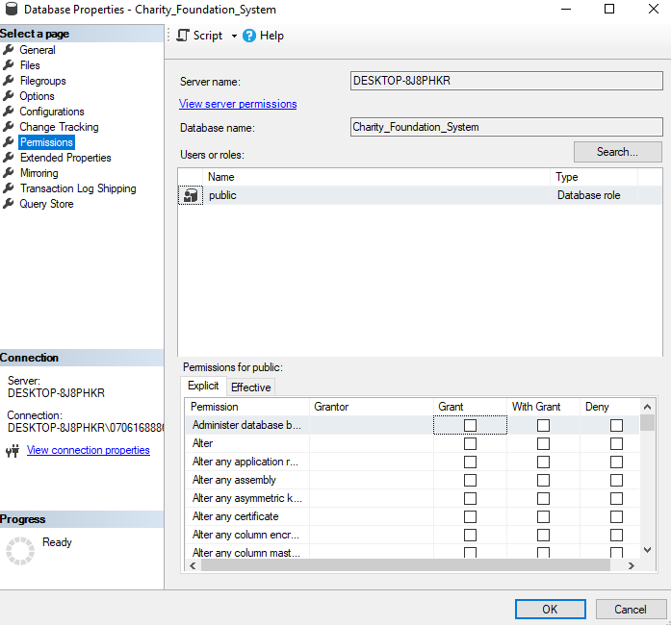
Managing Permissions using SQL server Management studio
For permissions to users we can use SQL server management studio, open SQL server and expand Database then expand your ideal database, right click the database and click properties. Choose the permissions page and click the search button on that page you can authorize the users to what that to do.

Slide 9
Changing trucking
Change trucking means truck the change on database that changed in all tables like update, delete, insert to show us and also allow us to who is changed data when and how change the data.
We use tow way for change trucking Triggers and Change Data Capture (CDC)
Triggers: this program is used automatically active when any changing on data
Change data capture: is internal SQL server program that truck data changing from transection log without using ttiggers.
Example 12.28
USE sample;
EXECUTE sys.sp_cdc_enable_table
@source_schema = N’Charity_Foudation’,
@source_name = N’Donor’,
@role_name = N'cdc_admin';

Slide 10
Data security and views
Using data security and views for the following purpose:
To restrict the use of particular columns and row of tables: maybe some column and row be secure from the users is better
To hide the details of complicated queries: using views to hide the internal structure of the database from users
To restrict inserted and updated values to certain ranges: with views can specify the user to what data can insert and how it can update.

Slide 11
Conclusions:
Authorization means specific the user levels access to database and data
There are three transact-SQL statement are related to authorization:
GRANT
DENY
REVOKE
Managing Permissions using SQL server Management studio
Change trucking means truck the our database that changed in all tables like update.
Reference: SQL server 2019 A Beginner’s Guide

Slide 12
Thank you Dears!

